Slide 1

U.S. Crime Data
Chris Klepacki, Dan Deluca, Christian Reilly

Slide 2
Research Question
Is there is statistically significant correlation between population growth and crime incidence?
Notes:
We wanted to check if when population increases, does crime increase the same, or act in a different manner because of new laws and regulations

Slide 3
Basic Variables
State | Decade | Year | Population
Pennsylvania | 1960s | 1960 | 11319366
Pennsylvania | 1960s | 1961 | 11468000
Pennsylvania | 1960s | 1962 | 11376000
… | … | … | …
Pennsylvania | 2000s | 2008 | 12448279
Pennsylvania | 2000s | 2009 | 12604767
Pennsylvania | 2010s | 2010 | 12717722

Slide 4
Property Crime Variables
rateP_burglary
rateP_larceny
rateP_motor
rateP_all
totP_burglary
totP_larceny
totP_motor
totP_all

Slide 5
Violent Crime Variables
rateV_assault
rateV_murder
rateV_rape
rateV_robbery
rateV_all
totV_assault
totV_murder
totV_rape
totV_robbery
totV_all

Slide 6
First, we examined National statistics…

Slide 7
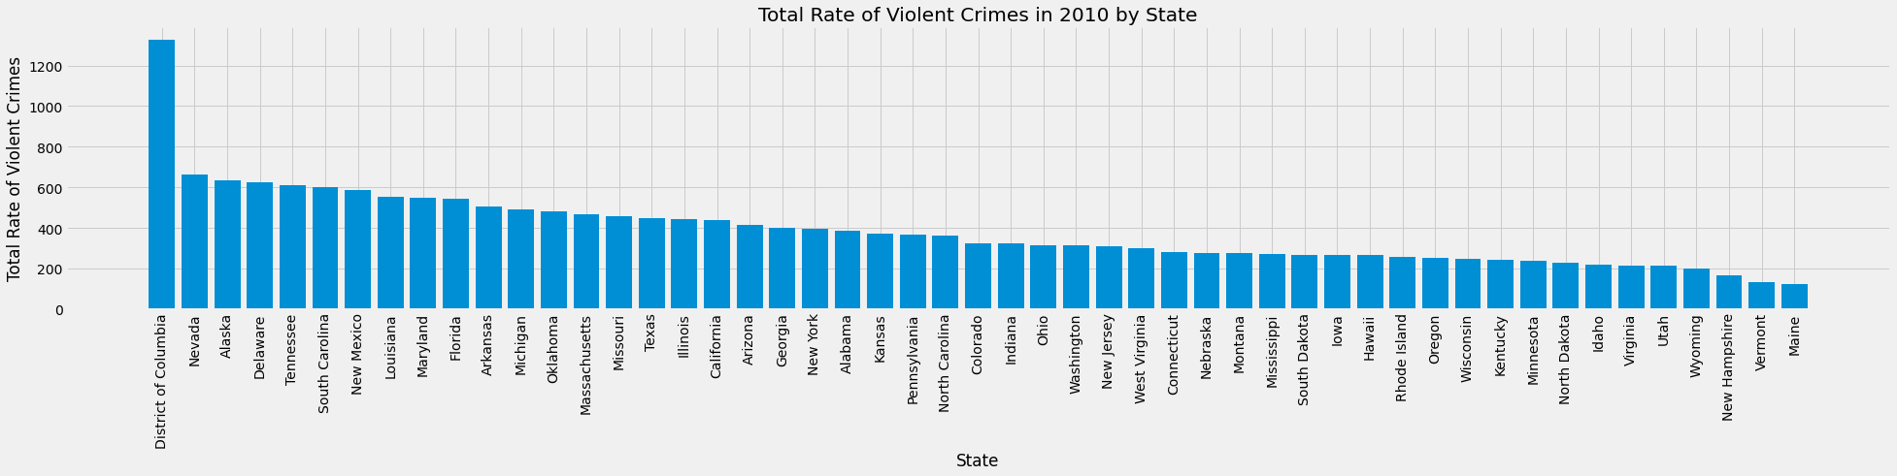

Slide 8
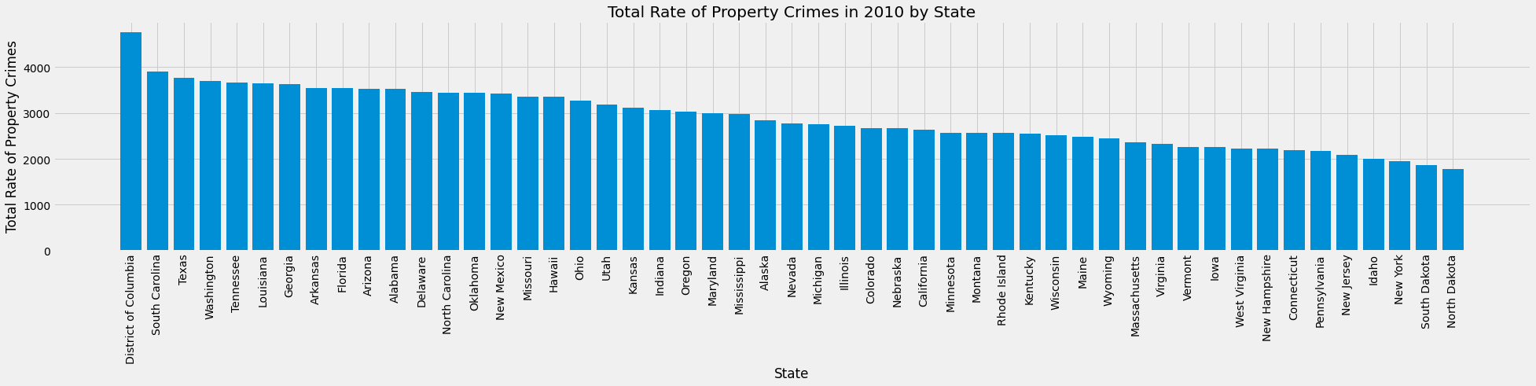

Slide 9
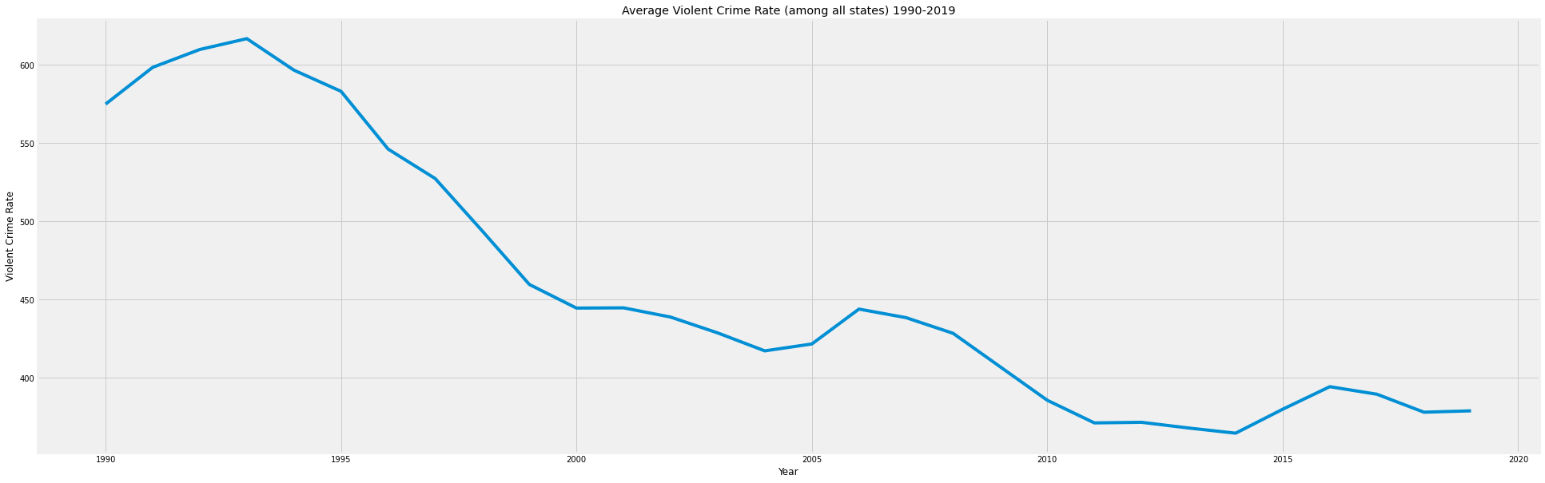
Has violent crime or property crime changed the most since 1990?
Average Violent Crime Rate Among all States (1990-2010)
This line graph shows the average violent crime among all states per year from 1990-2010.
It shows a significant peak in the early 90s and a sharp decrease since then.

Slide 10
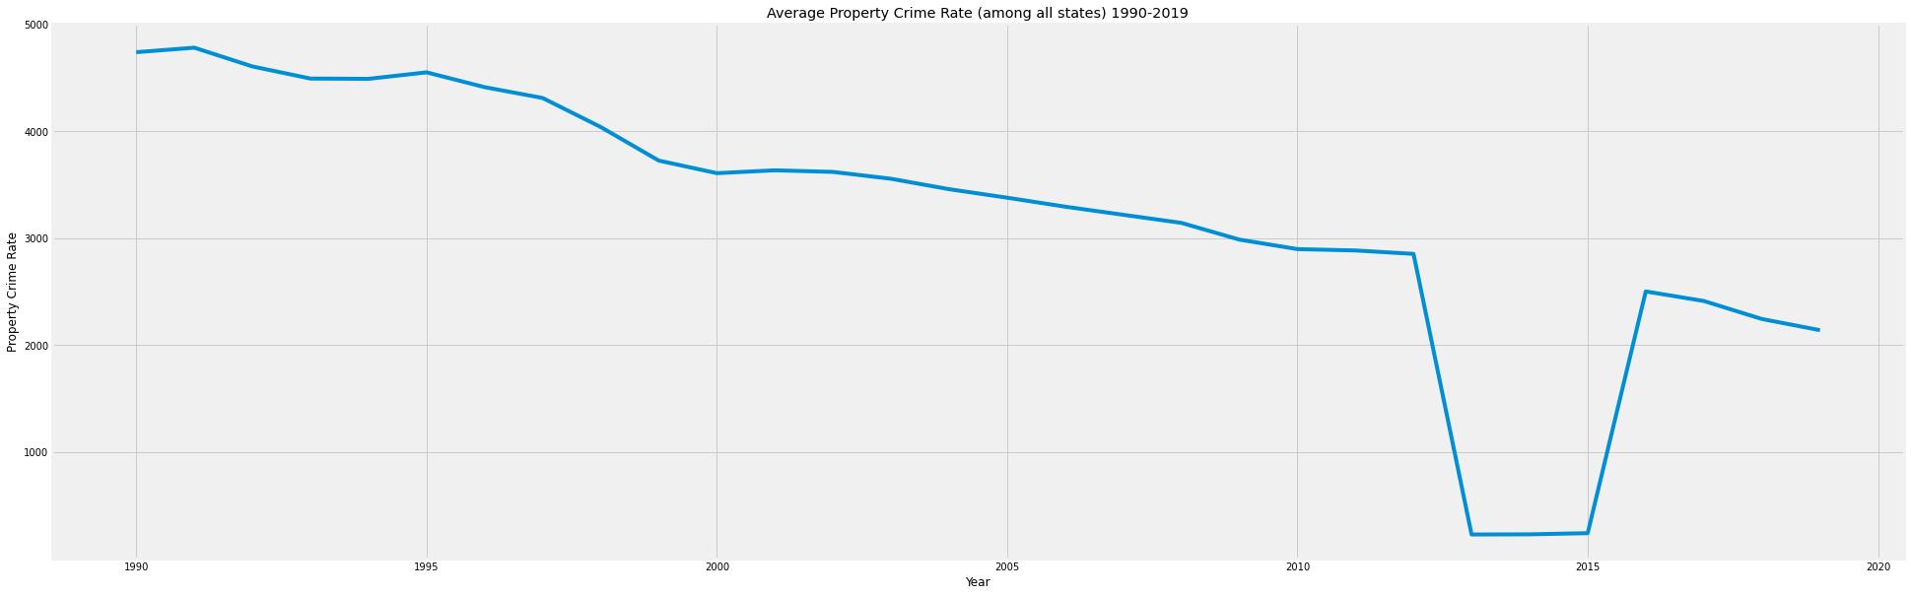
Has violent crime or property crime changed the most since 1990?
Average Property Crime Rate Among all States (1990-2010)
This line graph shows the average property crime among all states per year from 1990-2010.
It shows a very high average rate in the early/mid 1990s with a steady decrease since then

Slide 11
Has violent crime or property crime changed the most since 1990?
Both violent crime and property crime have sharply decreased since 1990
Violent crime has has a sharper decrease then property crime

Slide 12
Then, we examined Pennsylvania statistics exclusively…

Slide 13
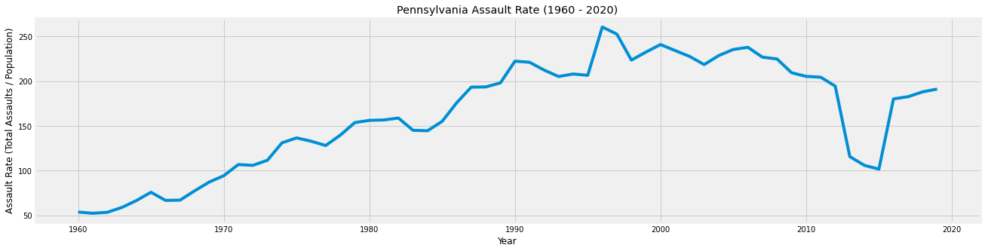
What year did the state of Pennsylvania have the highest assault crime rate? How has it changed since that year?
PA Assault Crime Rate (1960-2010)
This line plot shows the change is assault rate in Pennsylvania between 1960 and 2010.
It shows that the assault rate peaked during the mid 1990s

Slide 14
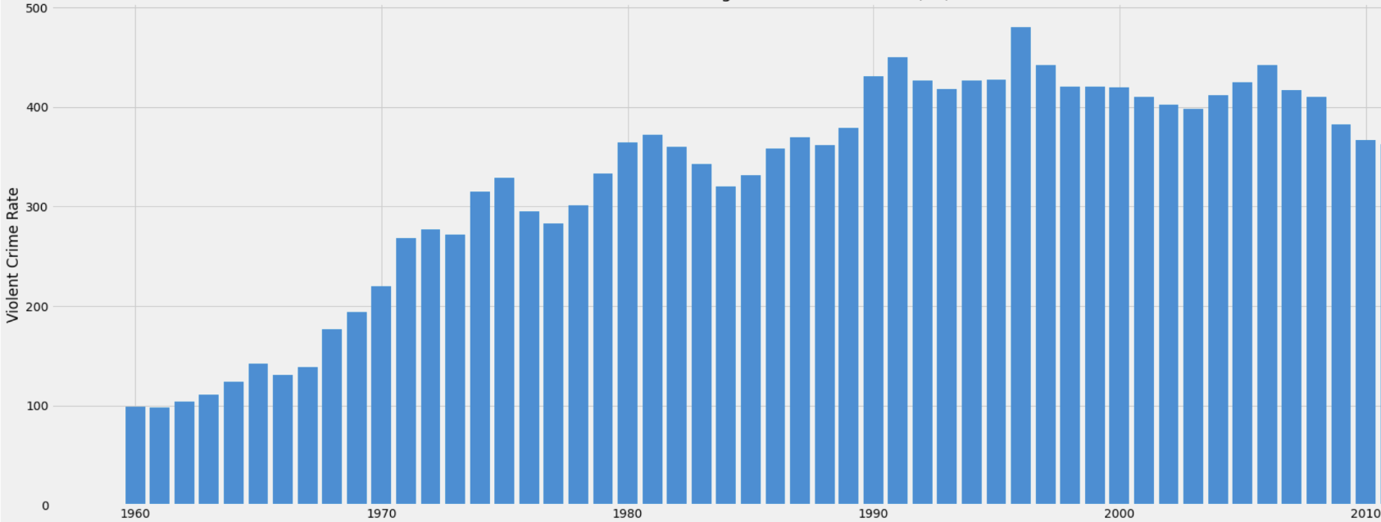
How has the violent crime rate in PA changed over time?
VIOLENT CRIME RATE FROM 1960-2010
YEAR
This bar graph shows the how the crime rate has changed over time
Notes:
1995 high, 1961 low

Slide 15
Finally, we looked at all crimes together…

Slide 16
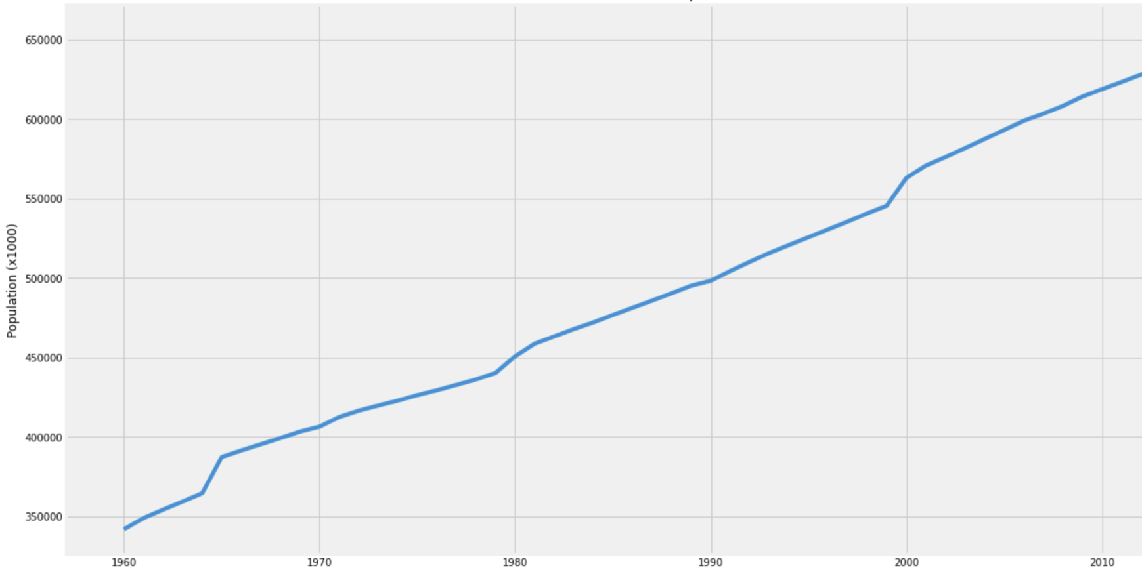
How has crime changed in the United States due to population change from 1990-2010?
U.S. Population (1960-2010)
Year

Slide 17
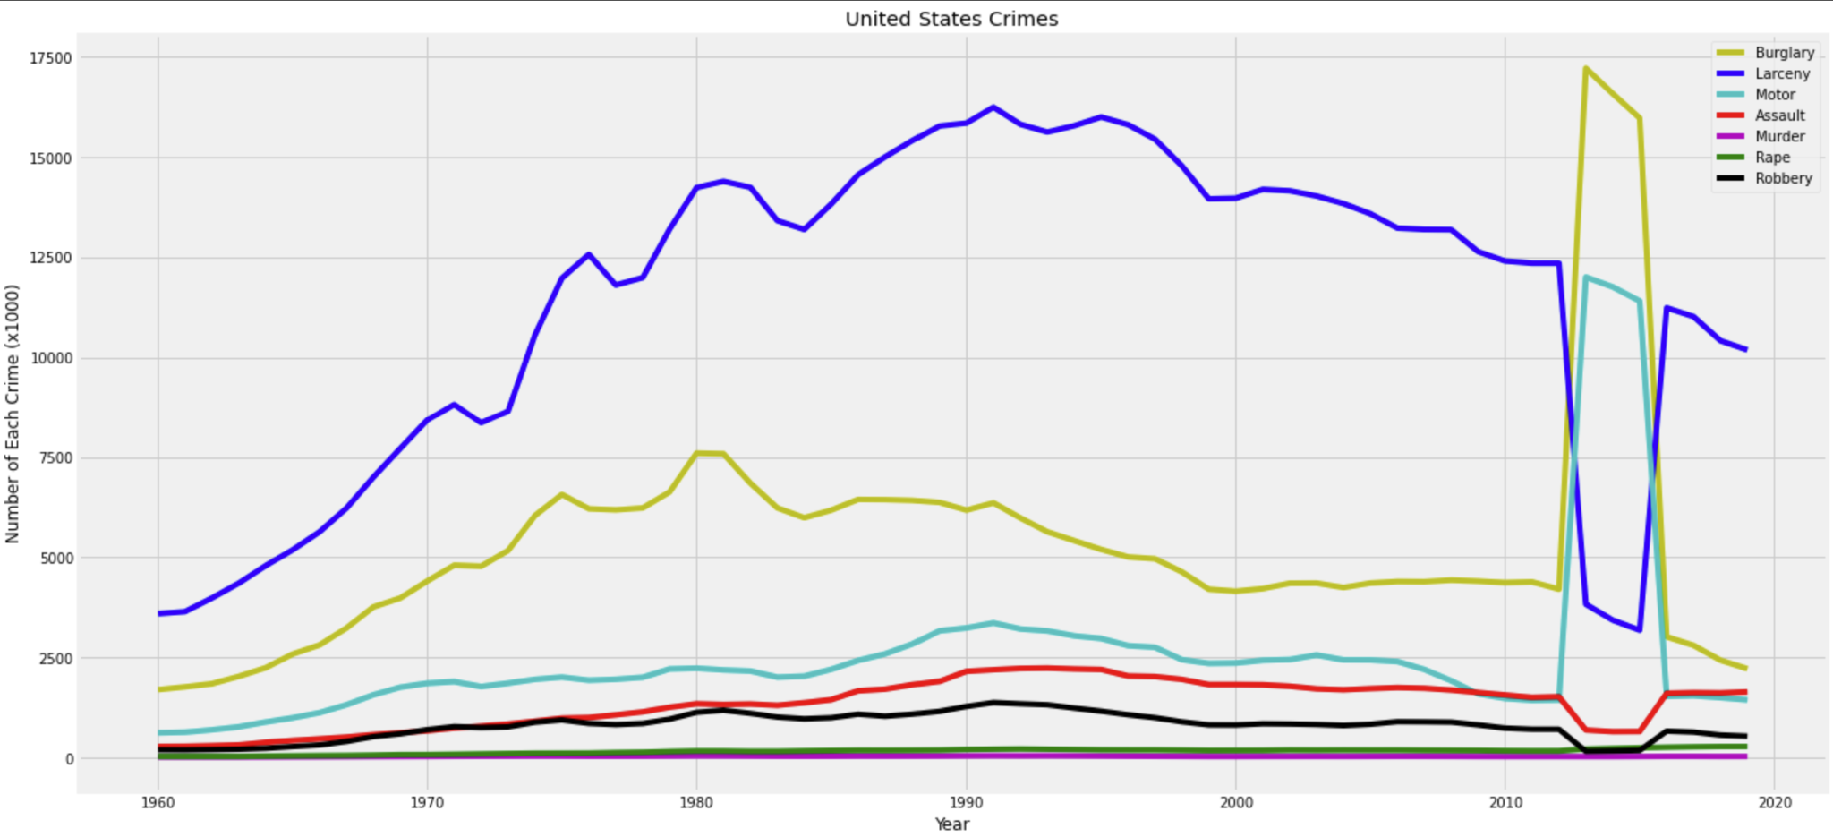
U.S Crime Rates (1960-2010)
Year
Notes:
Similar trends

Slide 18
Conclusion
Clear peak in most types of crime
Property crimes more volatile
Overall, we are on a downward trend
Notes:
Peak happened in the 90s, and sometime sooner
Especially assault which have a significant drop since their peak
Visualizations ending with 2010 show us following a downward trend

Slide 19
Future Work
Examining more of the data and incorporating more variables individually
Comparing more states individually to see if crime distributions change
—————————
How do the crime rate distributions between the safest and least safe state compare/contrast?
Notes:
There were so many different variables that we didn’t get a chance to incorporate them all, at least not on an individual level

Slide 20
Lessons and Challenges
Comparing large volumes of data between violent and property crime
Inaccuracies with our data post 2010
—————————
Learned to be careful with selecting data
Learned the importance of good questions
Notes:
2. Inaccuracies with data between 2012 to 2017 forced us to cut our analysis off at 2010. We researched and ensured that 1960-2010 data was accurate, to a data input error must have occurred in the mid 2010s.
3. Learned to better vet any data that is selected to make sure that it is complete and accurate
4. Learned the importance of asking good questions, especially when dealing with so much data, so that you can make accurate and widespread conclusions

